Slide 1
Automatic Treatment of Catalog Information
Caleb acree Advisor: Dr. Aubert In-field Reader: Dr. Nowatkowski HP Rep: Arthur Takahashi
Last edited: 11/19/2024

Slide 2
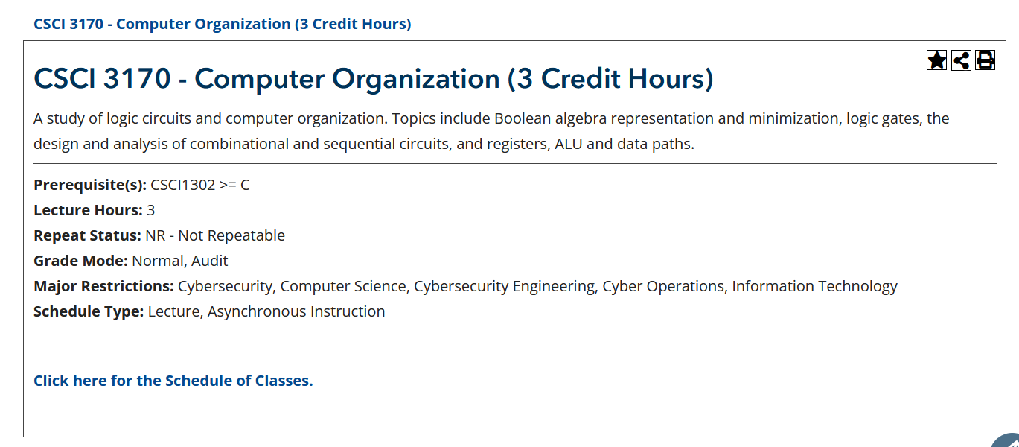
What and Why
The AU course catalog can often be slow, unresponsive, and not user-friendly
Additionally, it can fail to properly show the required information
I plan to design and create a free, user-friendly, and easily navigable tool for faculty and students to access and interact with the course catalog information

Slide 3
Background
In June of 2024, Dr. Aubert created a proof of concept for this type of tool
It was made using half JavaScript and half Shell
Comma separated value files were being generated but not with fully reliable information

Slide 4
How
I plan on creating a program that will automatically gather data from either the PDF version of the catalog or the web-based version
As of now I am looking into using Python and some shell
I will most likely be using Visual Studio Enterprise/Code
I am looking into the GNU General Public License v3.0 to potentially host this tool on github.io for long term use and maintenance

Slide 5
GNU General Public License v3.0
Commercial use: allows for commercial purposes without imposing any conditions on internal use
Modify and share: Users can modify the code, but they must also release the source code under the GPL v3 license
Distribute copies: Users can distribute copies or modifications of the code, as long as these are also released under the GPL v3 license
Offer warranty: Distributors can offer their own warranty on the licensed software.

Slide 6
Summary
I plan to create this tool to gather and display the course catalog information in an easily navigable tool
I will program this tool most likely using Python and Visual Studio Code/Enterprise
I want to make finding class information easily readable and accessible to students and faculty

Slide 7
Any Questions?

